Slide 1



Atliq Hardware
Code Basics
Resume Challenge 4
AtliQ
Consumer Goods
AD- Hoc Analysis
Presented by – Prachi sharma

Slide 2
Agenda
1-
Background
Problem Statement
Task
Approach
Insights and Visualization
2 -
3 -
4 -
5 -

Slide 3
Background
About Company
Atliq Hardwares (imaginary company) is one of the leading computer hardware producers in India and well expanded in other countries too
Problem Statement
The management noticed that they do not get enough insights to make quick and smart data-informed decisions. They want to expand their data analytics team by adding several junior data analysts. data analytics director wanted to hire someone who is good at both tech and soft skills.

Slide 4


Task
There are 10 ad hoc requests for which the business needs insights.
Approach
run a SQL query to answer these requests.
Convert query results into Visualization it to top level management.
Tools Used -

Slide 5
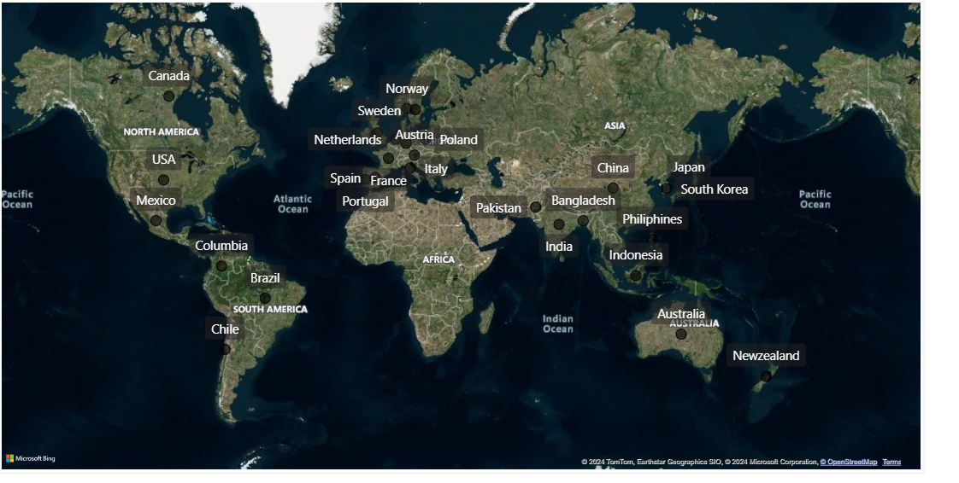
Getting familiar with the Market and Products
AtliQ
Market

Slide 6
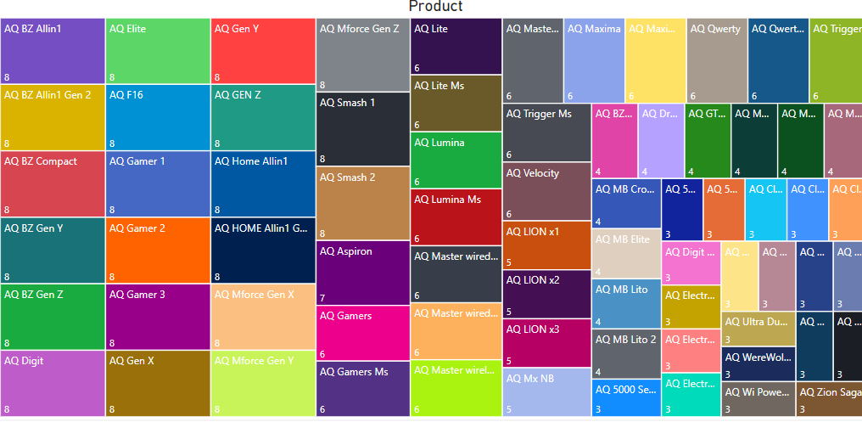
Products

Slide 7
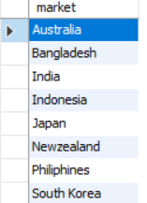
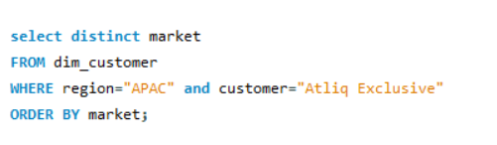
AD-Hoc Request – 1
1. Provide the list of markets in which customer "Atliq Exclusive" operates its business in the APAC region
Query
RESULT –

Slide 8
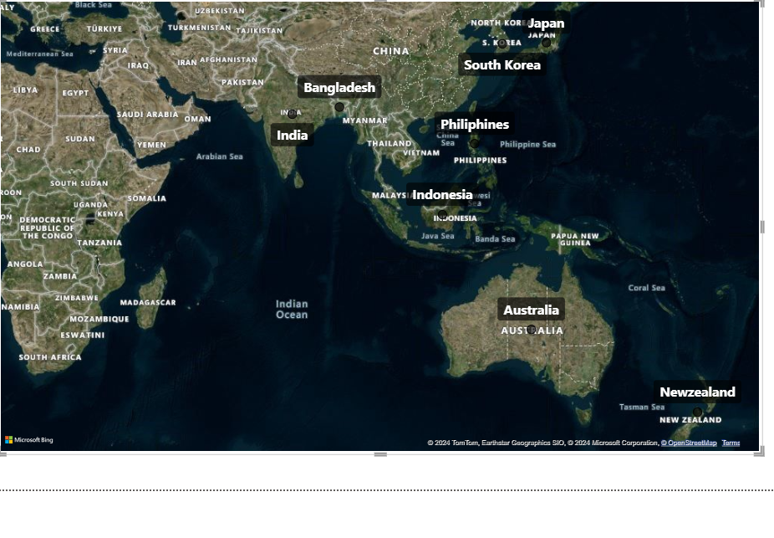
AD-Hoc Request – 1
Insights
There are 8 market in the APAC region where Atliq Exclusive Operates it’s Business

Slide 9
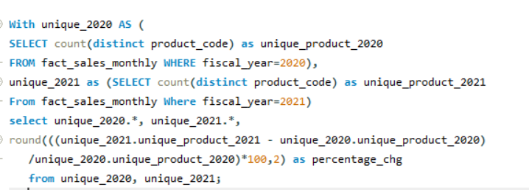
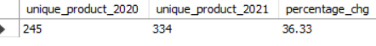
AD-Hoc Request – 2
2- What is the percentage of unique product increase in 2021 vs. 2020? The final output contains these fields,
unique_products_2020
unique_products_2021
percentage_ chg
Query
RESULT –

Slide 10
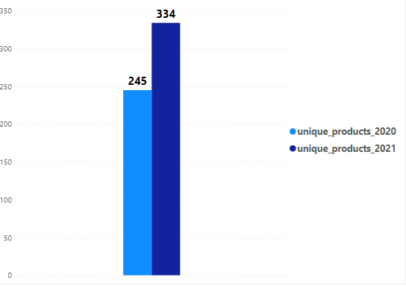
AD-Hoc Request – 2
Insights
36.33 %
Increase

Slide 11
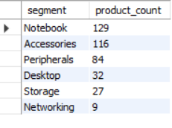
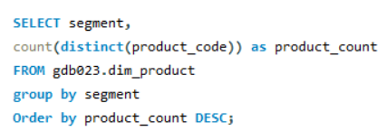
AD-Hoc Request – 3
3- Provide a report with all the unique product counts for each segment and sort them in descending order of product counts. The final output contains 2 fields,
segment
product_count
Query
RESULT –

Slide 12
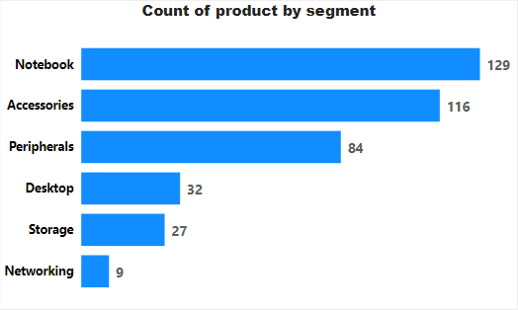
AD-Hoc Request- 3
Insights

Slide 13
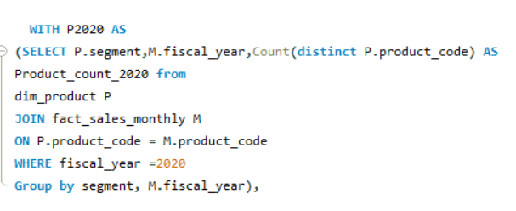
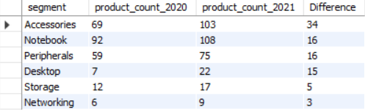
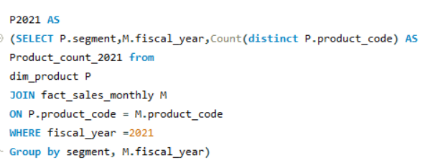
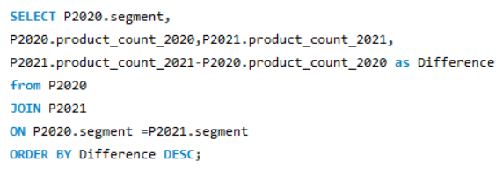
AD-Hoc Request- 4
4- Follow-up: Which segment had the most increase in unique products in 2021 vs 2020? The final output contains these fields, segment product_count_2020 product_count_2021 difference
Query
RESULT –

Slide 14
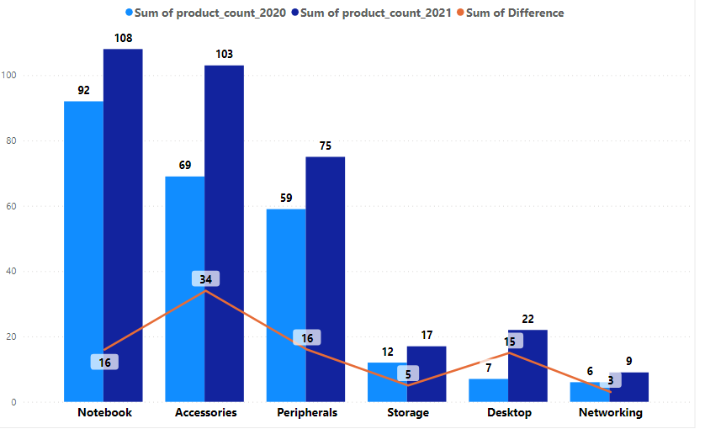
AD-Hoc Request- 4
Insights

Slide 15
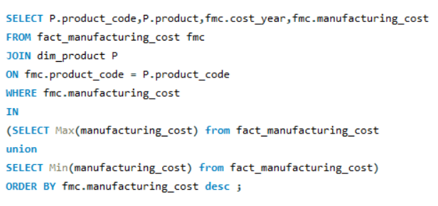
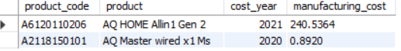
AD-Hoc Request- 5
5- Get the products that have the highest and lowest manufacturing costs. The final output should contain these fields,
product_code
product
manufacturing_cost
Query
RESULT –

Slide 16


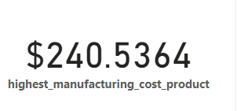
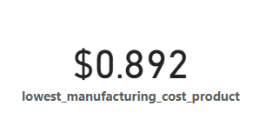
AD-Hoc Request- 5
Insights
AQ Home Alin1 Gen 2
AQ Master wiredx1 Ms

Slide 17
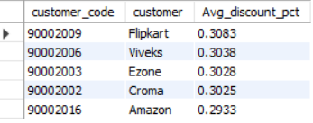
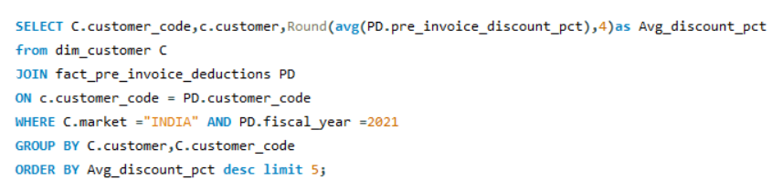
AD-Hoc Request- 6
6- Generate a report which contains the top 5 customers who received an average high pre_invoice_discount_pct for the fiscal year 2021 and in the Indian market. The final output contains these fields,
customer_code
customer
average_discount_percentage
Query
RESULT –

Slide 18
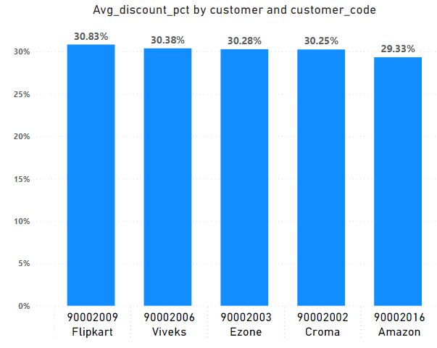
AD-Hoc Request- 6
Insights

Slide 19
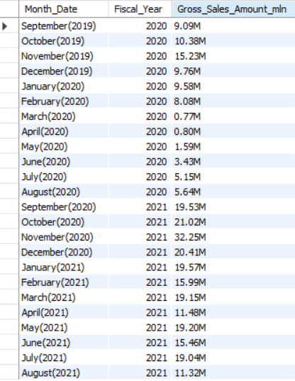
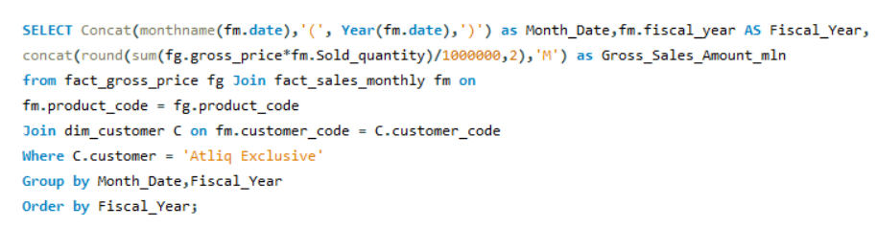
AD-Hoc Request- 7
7- Get the complete report of the Gross sales amount for the customer “Atliq Exclusive” for each month. This analysis helps to get an idea of low and high-performing months and take strategic decisions. The final report contains these columns: Month Year Gross sales Amount
Query
RESULT

Slide 20
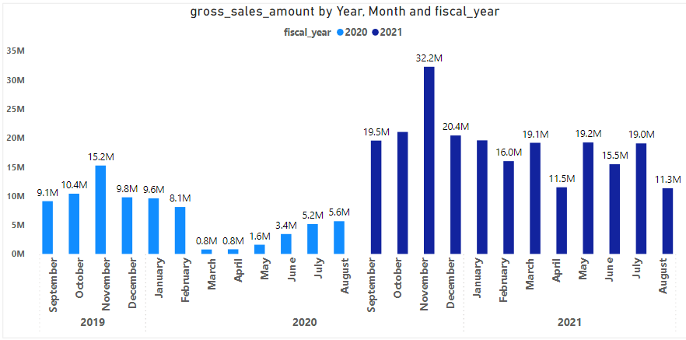
AD-Hoc Request- 7
Insights

Slide 21
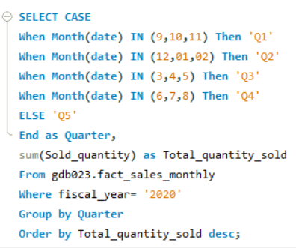
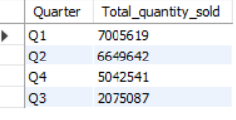
AD-Hoc Request- 8
8- In which quarter of 2020, got the maximum total_ sold_ quantity? The final output contains these fields sorted by the total_ sold_ quantity,
Quarter
total_sold_quantity
Query
RESULT –

Slide 22
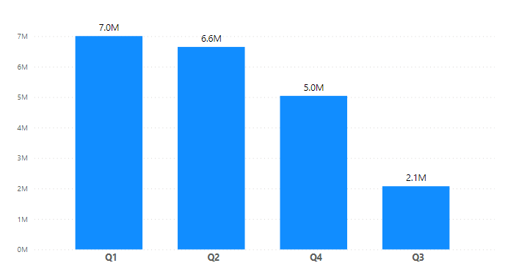
AD-Hoc Request- 8
Insights

Slide 23
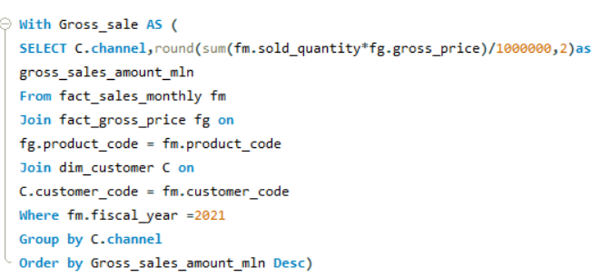
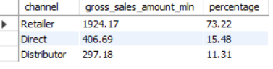
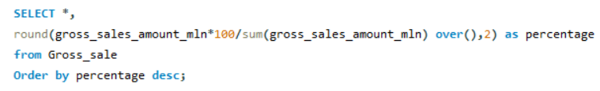
AD-Hoc Request- 9
9- Which channel helped to bring more gross sales in the fiscal year 2021 and the percentage of contribution? The final output contains these fields, channel gross_sales_mln percentage
Query
RESULT –

Slide 24
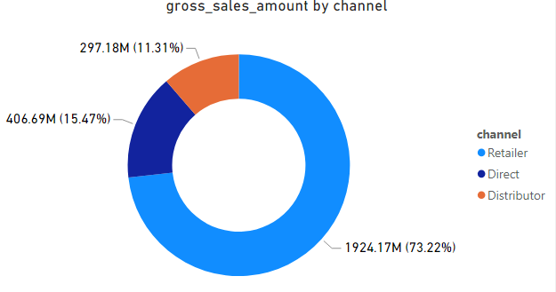
AD-Hoc Request- 9
Insights

Slide 25
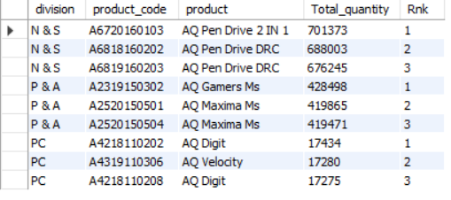
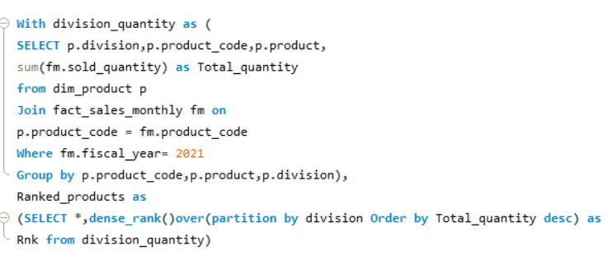

AD-Hoc Request- 10
10- Get the Top 3 products in each division that have a high total_sold_quantity in the
fiscal_year 2021? The final output contains these fields,
division
product_code
product
Total_sold_quantity
rank_order
Query
RESULT –

Slide 26
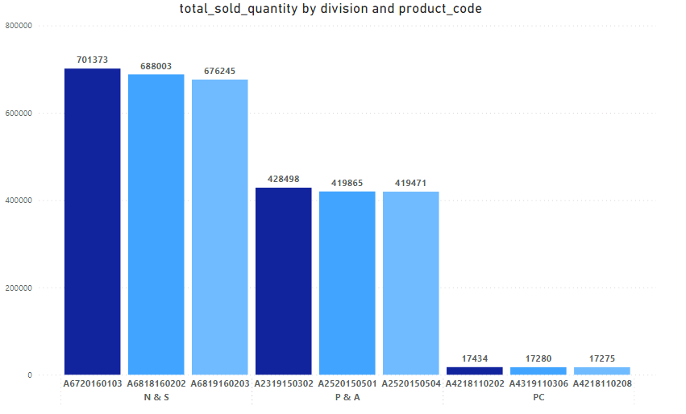
AD-Hoc Request- 10
Insights

Slide 27
Thank you

